Slide 1
Campus Price & Dice
(Working title)
Chris Collins, Wassim Katbey, Derrick White

Slide 2
What does our application do?
CRUD (Create/Read/Update/Delete)
Display Campus Restaurant data
Restaurants, their locations, and hours
The restaurant’s items, and their prices
The average/minimum/maximum price of each item

Slide 3
Web Application
Back-End: Python (Django Framework) and MySQL
Front-End: HTML, CSS, Bootstrap CSS, and (some) Vanilla Javascript

Slide 4
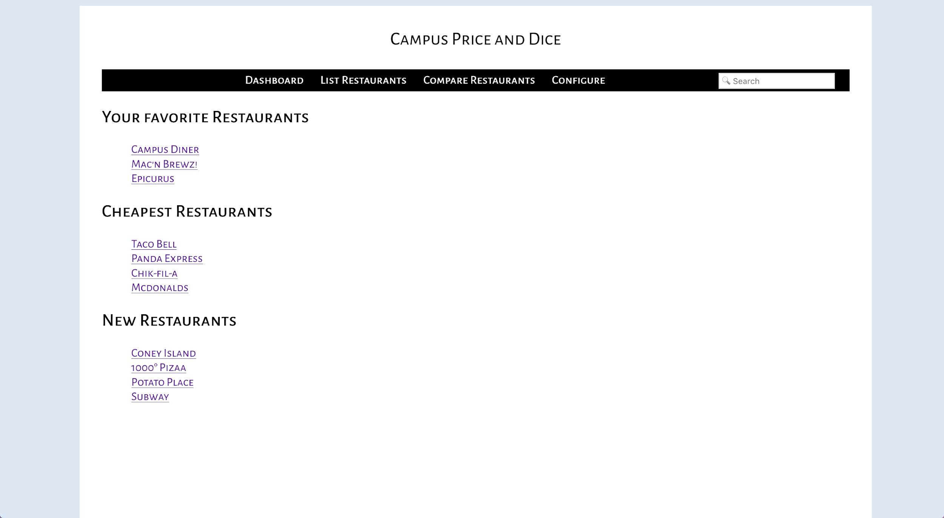
Prototype: Dashboard View

Slide 5
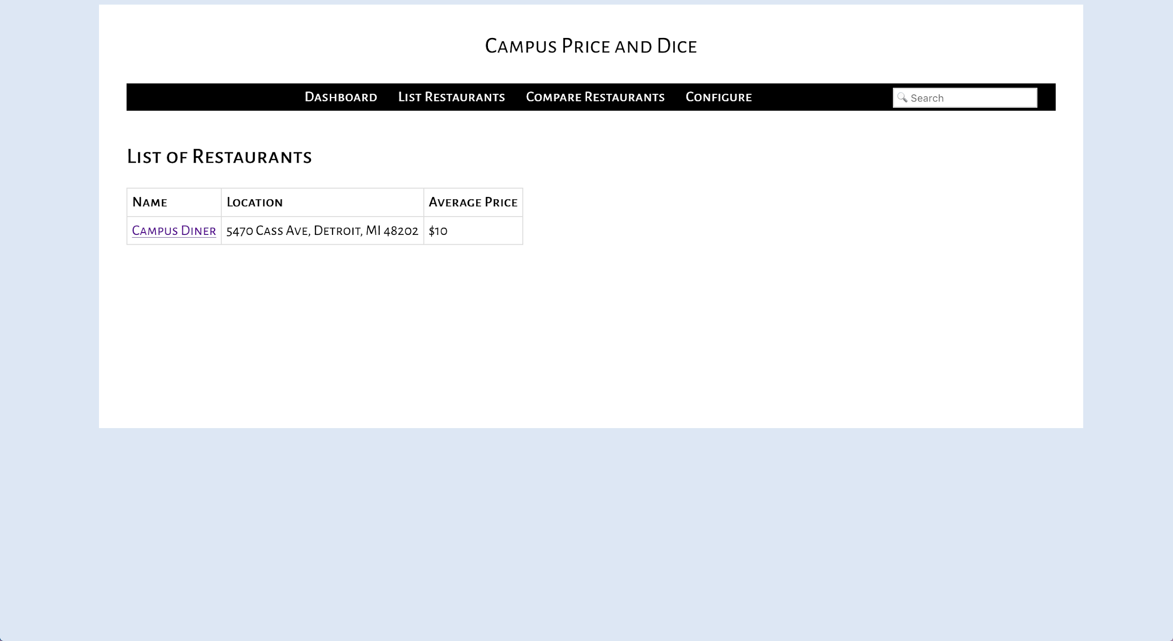
Prototype: List of Restaurants View

Slide 6
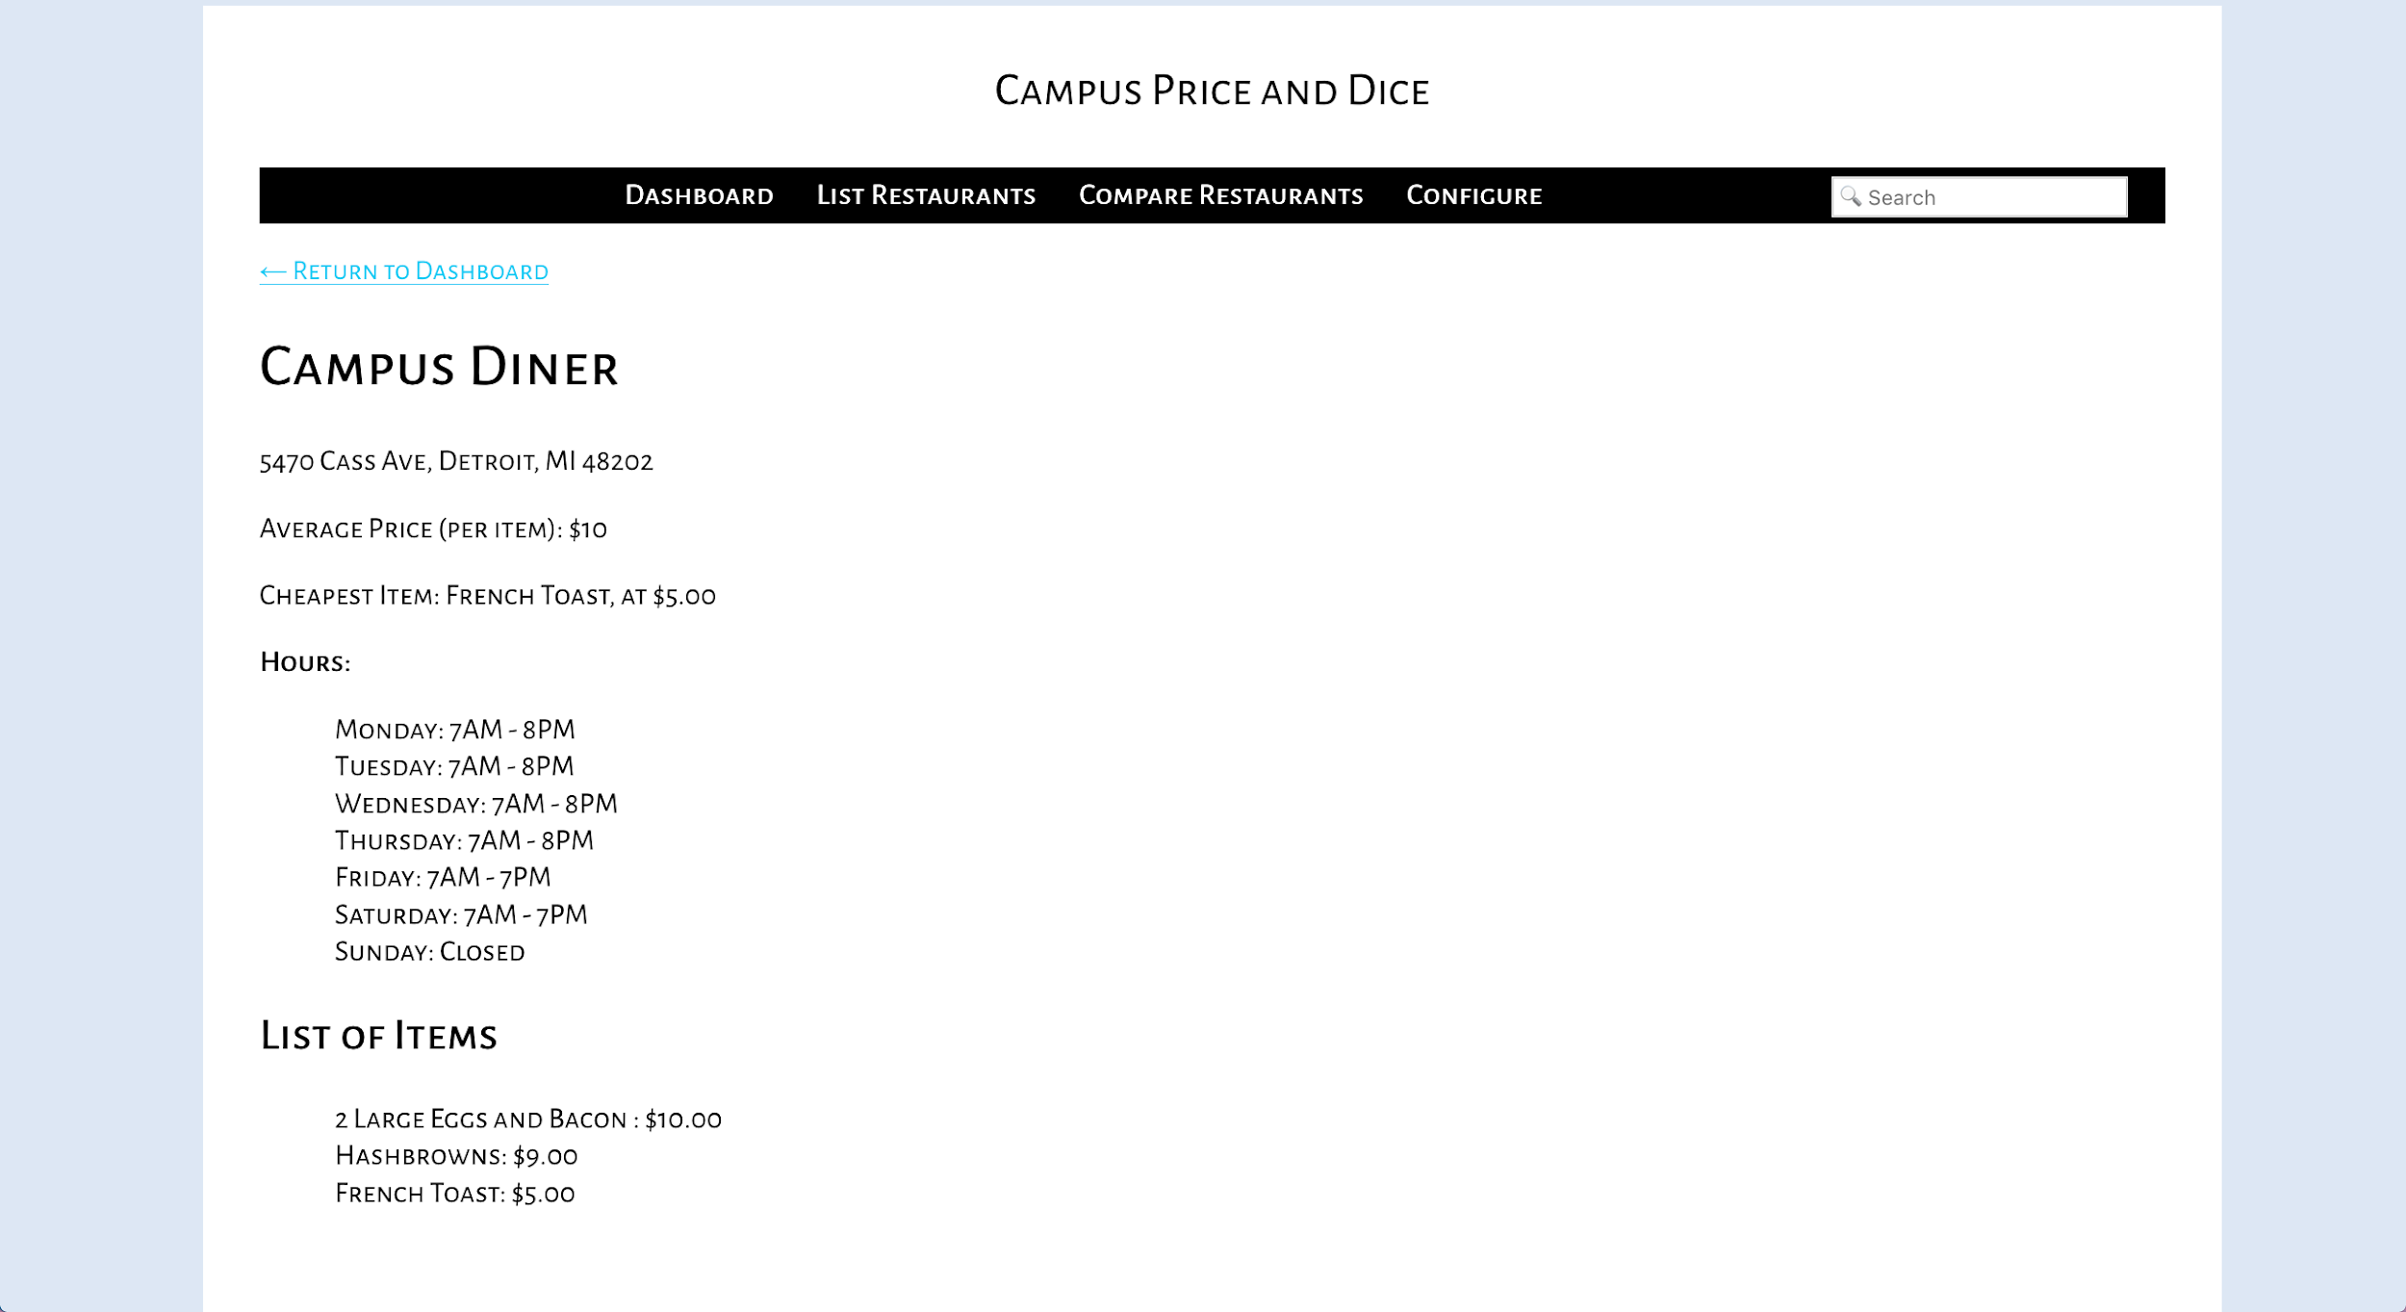
Prototype: Restaurant View

Slide 7
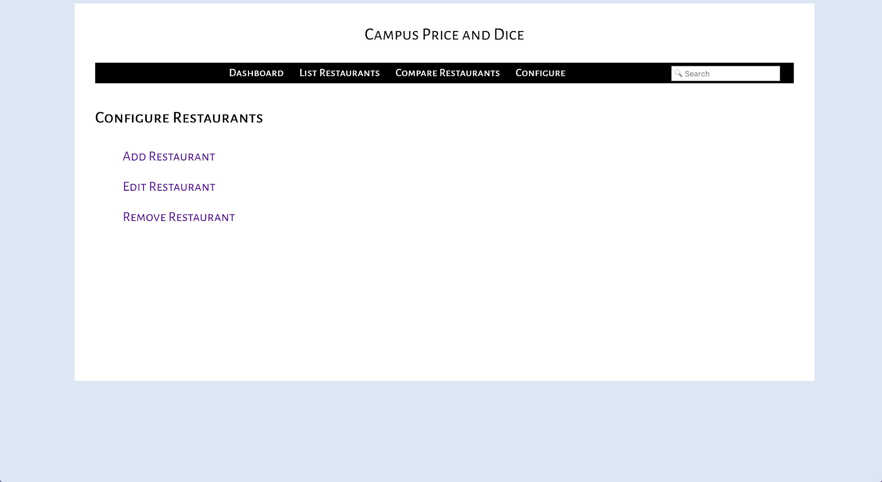
Prototype: Configure View

